Slide 1
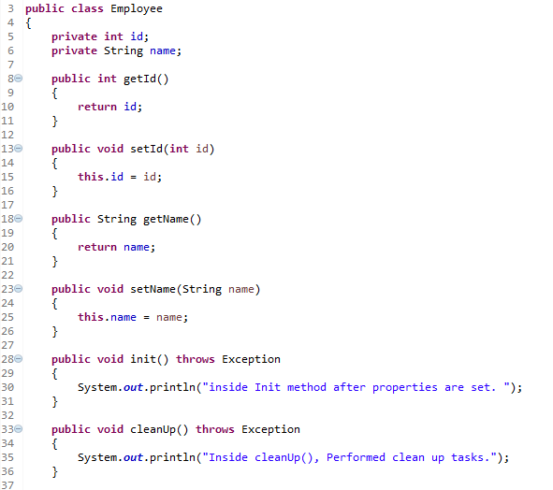
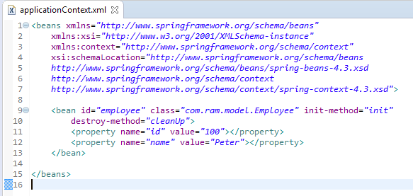

Spring init-method and destroy-method
In Spring, we can use init-method and destroy-method as attribute in bean configuration file for bean to perform certain actions upon initialization and destruction. Alternative to InitializingBean and DisposableBean interface.

Slide 2
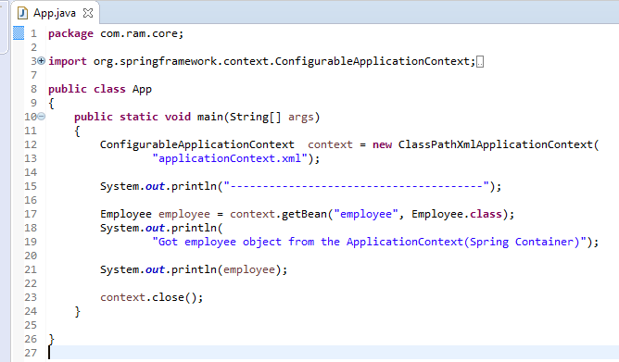
Spring init-method and destroy-method
The ConfigurableApplicationContext.close()will close the application context, releasing all resources and destroying all cached singleton beans.

Slide 3
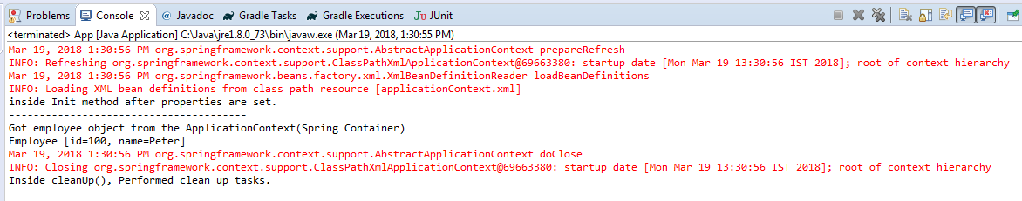
Spring init-method and destroy-method
The init() method is called, after the id and name property is set.
The cleanUp() method is called after the context.close();
Better not to use InitializingBean and DisposableBean interface, because it will tight coupled your code to Spring.
A better approach should be specifying the init-method and destroy-method attributes in your bean configuration file.

